Slide 1
Gamma 1

Slide 2































Slide 3













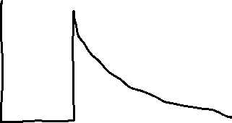










Slide 4














High gamma energies result from low beta energies, so gammas with high energy are probable.

Slide 5

















































Slide 6










































Slide 7



































Slide 8








See LL2 sec 66.

Slide 9














































Slide 10


















Slide 11
































Slide 12































Slide 13






















Slide 14


























Slide 15





















Slide 16





















Slide 17



















Slide 18

















































Slide 19







































Slide 20























Slide 21































Slide 22







































Slide 23
Rigorous Classical Radiation Theory
Dipole radiation: LL2 section 67
Quadruole and magnetic dipole radiation: LL2 section 71
Rigorous Quantum Radiation Theory
LL4 Quantum Electrodynamics Chapter V “Radiation”.

